Slide 1
Uses of computer in various fields of life

Slide 2
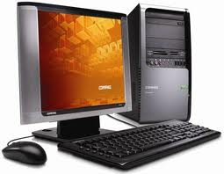

Slide 3
Computers are used for all aspects of running a business. Computer use in a business enhances productivity and provides results that might not otherwise be possible. Businesses use computers to keep records, develop budgets and forecasts, prepare marketing documents, research and stay in contact with other employees and customers. Businesses should look at their operation and ensure that they are using their computers to the fullest extent.
In business

Slide 4
The first computers used by businesses that were so expensive, they could only be afforded by the largest and richest companies. Today, even the smallest company has a computer perched on almost every desk, and each one of those computers has many times the processing power of those old. Computers today have become important to every segment of business operations.

Slide 5
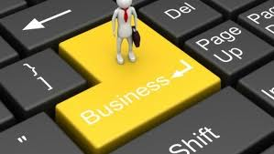
USE OF COMPUTER IN BUSINESS
Marketing
Stock exchange
Banks
Departmental stores

Slide 6

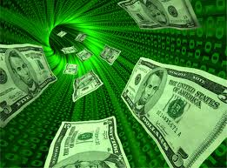
Uses of computer in e - commerce
electronic mail
video conferencing
electronic shopping
electronic banking

Slide 7
Research
Businesses can use the Internet to research its competitors' products and prices by studying their websites.
They can also get a glimpse into how customers view their own products by reading customer reviews on sites such as Amazon.
When launching a new product a company can perform market research using online questionnaires and surveys.

Slide 8
COMPUTERS IN BANKS
Handle trading in multiple currencies
Automatic teller machine
Facsimile (FAX), electronic mail (E.mail), and voice mail are used to transfer messages etc conveniently and easily

Slide 9
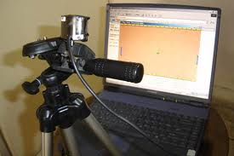
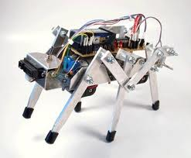
USE OF COMPUTER IN INDUSTRY
robots
machinery status and running
observance of temperature and pressure accurately and precisely

Slide 10
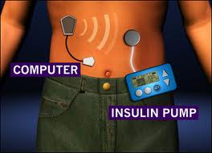
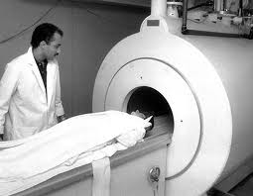
Computer is used in medics
Patient monitoring
patient records
diagnosis
hospital administration
medical history records
life support system

Slide 11

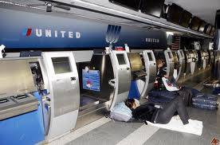
Computer’s role in airlines
Record of passengers
navigation system
connects pilot with service station

Slide 12
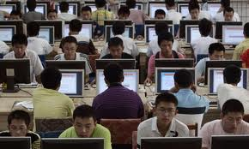
Education = 0 without computer
Better study moods
most understandable and easier
internet facility provides a lot of information from any corner of the world

Slide 13
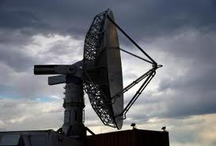
Weather forecasting
weather stations
airport satellites
humidity measurement
metrological studies

Slide 14

Home uses of a computer
kids play games
music collection
microprocessor technology aids in baking etc like microwave oven

Slide 15

Computer in tourism
keep records of tourists
information about visit able sites

Slide 16
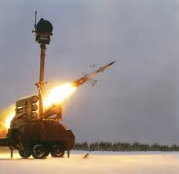
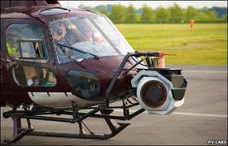
Defense field
control of ballistic missiles
modern radar system
used in planes and tanks to target enemy assets

Slide 17
Role of computers in nuclear field
Computers play a vital role in the function as well as simulation of these energy centers.
In Russia scientists have made a “fusion reactor “ with the help of computers

